Slide 1
Lecture 16 – Algorithm Design
Algorithm Design and Analysis, Algorithm Complexity, Linear Search
Kok-Seng Wong | 2021

Slide 2
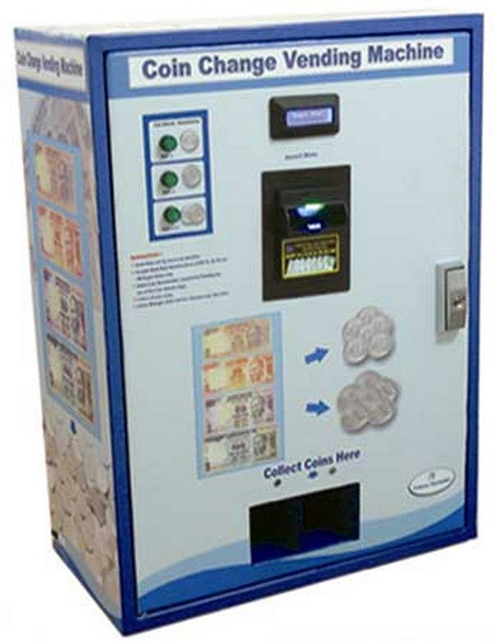
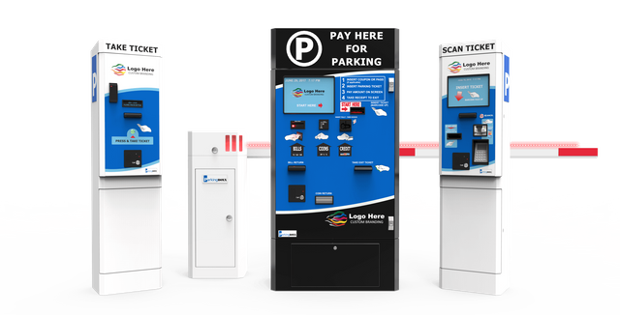
Motivation example 1
[source]
[source]

Slide 3
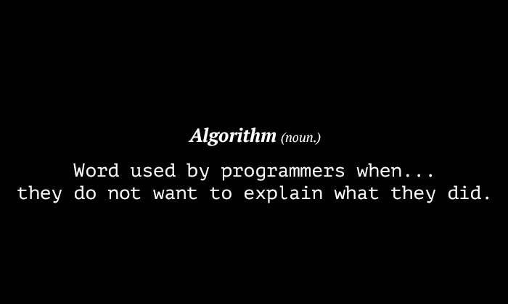
Motivation example 2
[source]

Slide 4
Learning outcomes
Upon the completion of this lecture, students will be able to:
understand fundamental techniques for designing and writing basic algorithms using Python.
carry out analysis (i.e., complexity) of algorithms.

Slide 5
Algorithm design
Algorithm is a step-by-step procedure: which defines a set of instructions to be executed in a certain order to get the desired output.
Algorithms are generally created independent of underlying languages, i.e., an algorithm can be implemented in more than one programming language.

Slide 6
Basic algorithms
Search − to search an item in a data structure.
Sort − to sort items in a certain order.
Insert − to insert item in a data structure.
Update − to update an existing item in a data structure.
Delete − to delete an existing item from a data structure.

Slide 7
Characteristics of algorithms
Unambiguous − Algorithm should be clear and unambiguous.
Input − An algorithm should have zero or more well-defined inputs.
Output − An algorithm should have one or more well-defined outputs, and should match the desired output.
Finiteness − Algorithms must terminate after a finite number of steps.
Feasibility − Should be feasible with the available resources.
Independent − An algorithm should have step-by-step directions, which should be independent of any programming code.

Slide 8
Algorithm analysis

Slide 9

Most efficient solution?
Algorithms are designed to solve problems.
BUT a given problem can have many different solutions.
How to determine which solution is the most efficient for a given problem?
Execution Time

Slide 10
Execution time
Also known as the running time of an algorithm.
The time needed for a specific input depends on the number of operations executed.
The greater the number of operations, the longer the running time of an algorithm.
We usually want to know how many operations an algorithm will execute in proportion to the size of its input, which we will call.

Slide 11
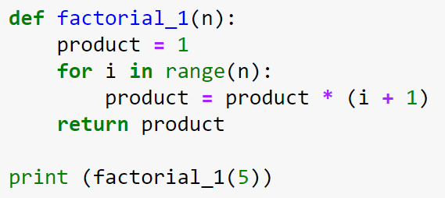
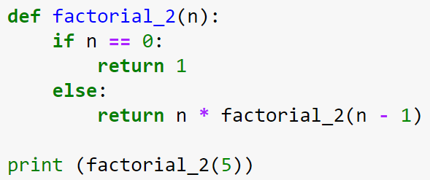
Algorithm execution time
Algorithm 1: Iterative Method
Algorithm 2: Recursive Method
recursion function

Slide 12
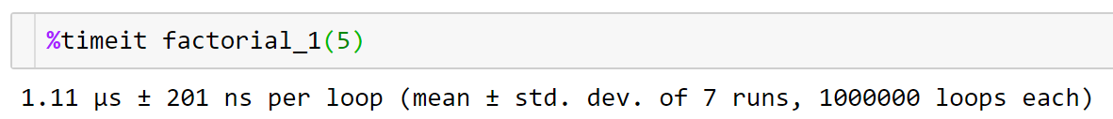
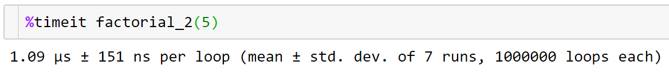
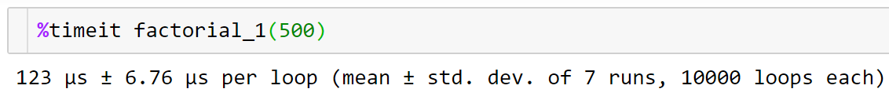
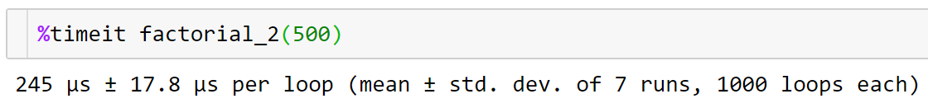
Time required to execute

Slide 13
Factors affecting Execution time
The execution time is dependent on several factors:
The amount of data that must be processed.
Type of hardware and the time of day a computer is used.
The choice of programming language and compiler used to implement an algorithm
Conclusion: execution time is not a good metric to measure the complexity of an algorithm!

Slide 14
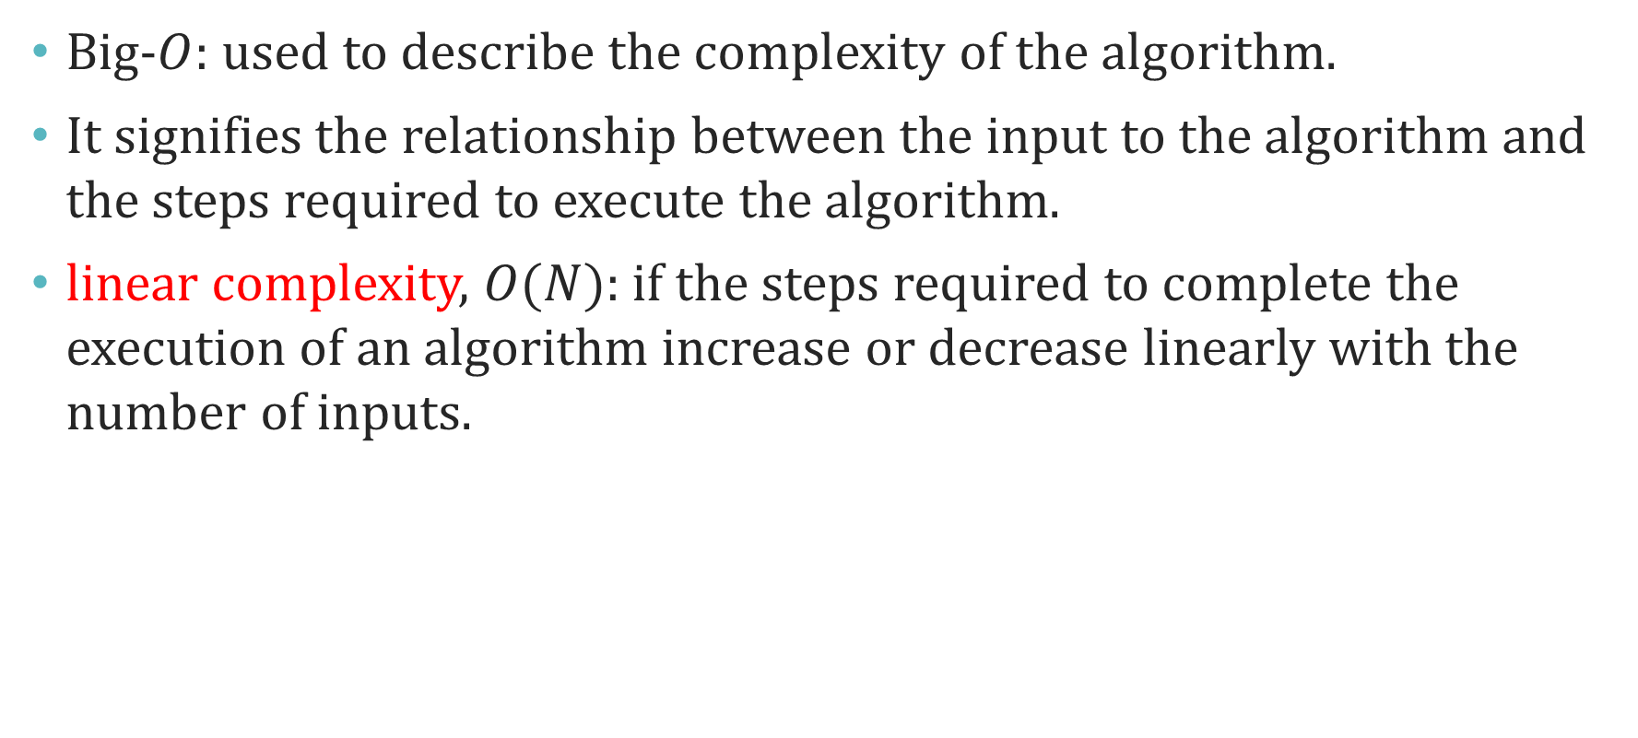

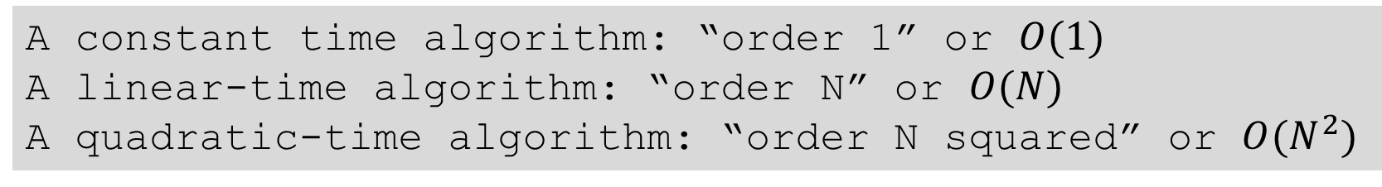
Big-$O$ notation
Big-$O$: used to describe the complexity of the algorithm.
It signifies the relationship between the input to the algorithm and the steps required to execute the algorithm.
linear complexity, $O(N)$: if the steps required to complete the execution of an algorithm increase or decrease linearly with the number of inputs.
A constant time algorithm: “order 1” or $O(1)$
A linear-time algorithm: “order N” or $O(N)$
A quadratic-time algorithm: “order N squared” or $O(N^{2})$

Slide 15
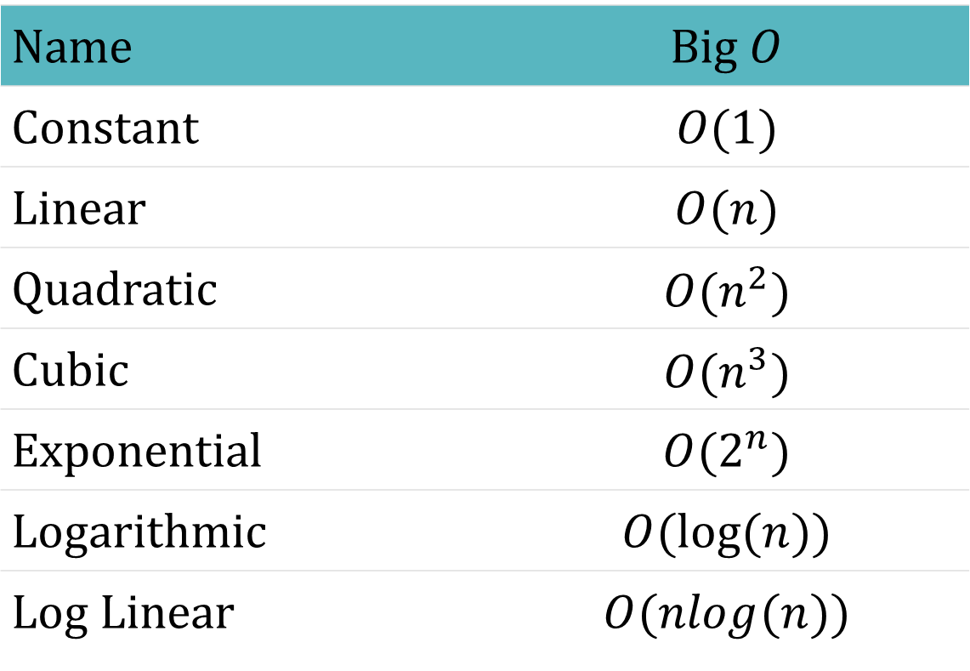

Some Common big-$O$ functions
Name | Big $O$
Constant | $$O(1)$$
Linear | $$O(n)$$
Quadratic | $$O(n^{2})$$
Cubic | $$O(n^{3})$$
Exponential | $$O(2^{n})$$
Logarithmic | $$O(log⁡(n))$$
Log Linear | $$O(nlog(n))$$

Slide 16

Sequence of statements
IF each statement is a basic operation, the time for each statement will be a constant.
Hence, total time is also a constant: $O(1)$
statement 1
statement 2
...
statement n
Total time = time(statement 1)+ time(statement 2)+…+ time(statement n)

Slide 17
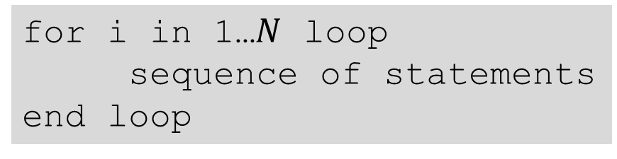
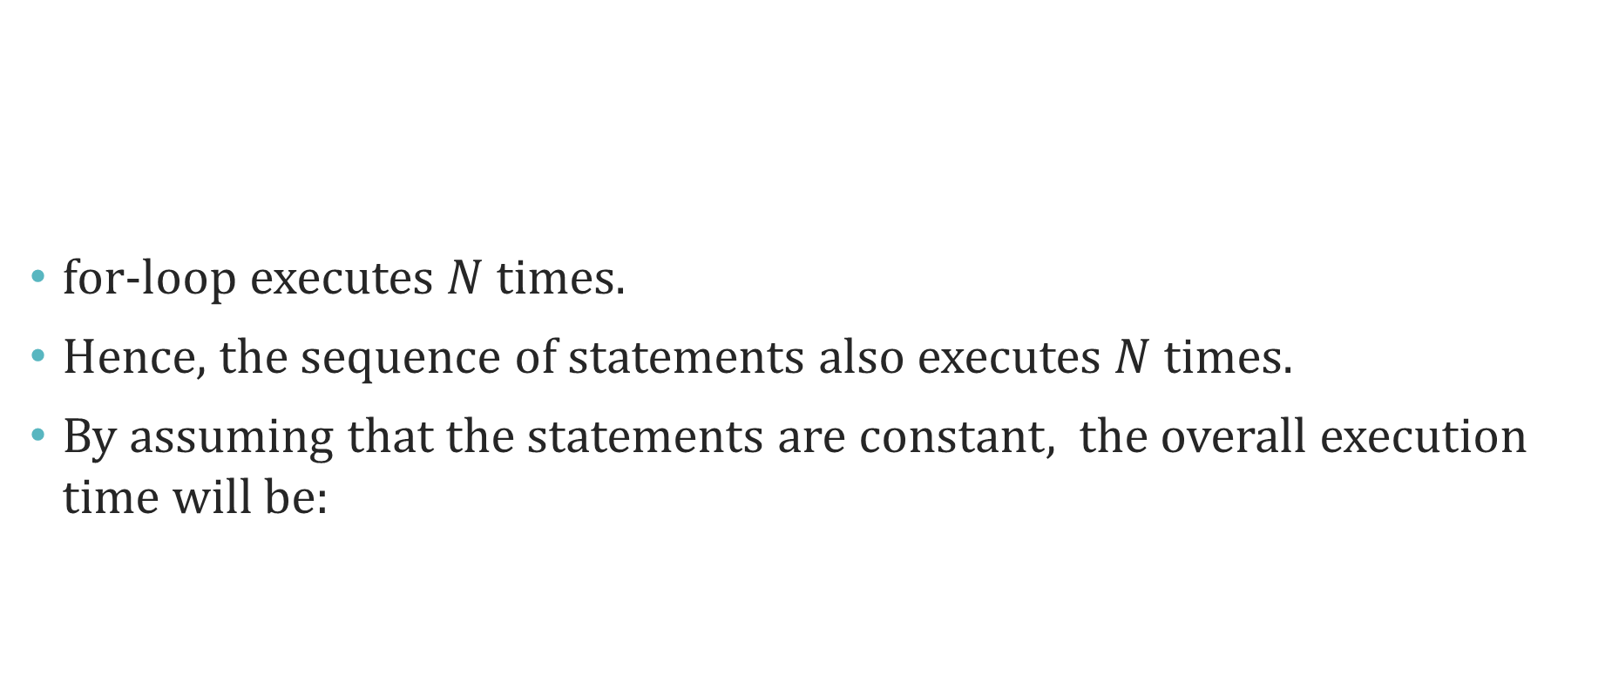
loops
for-loop executes $N$ times.
Hence, the sequence of statements also executes $N$ times.
By assuming that the statements are constant, the overall execution time will be:
for i in 1…$N$ loop
sequence of statements
end loop
Linear complexity
$$N∗O(1) =O(N)$$

Slide 18
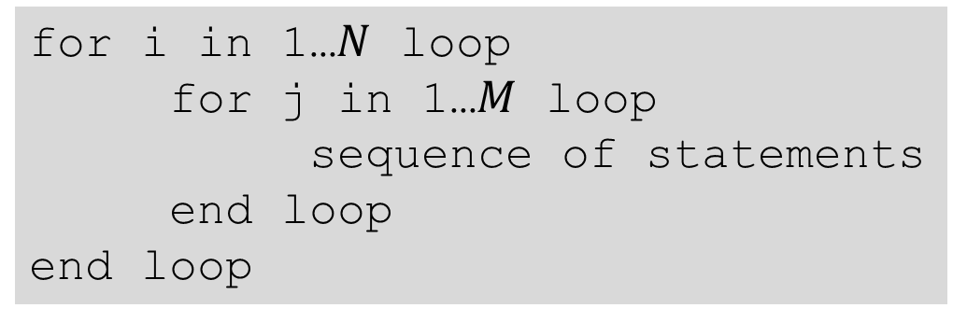
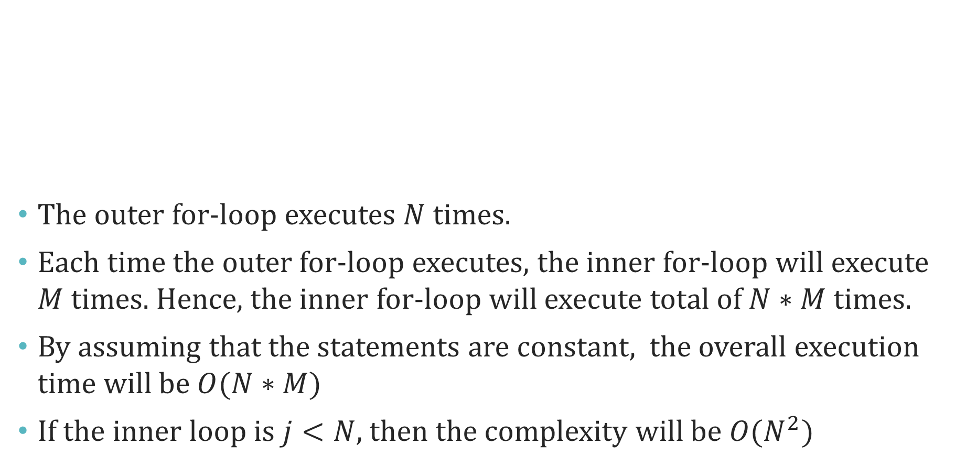
Nested-loops
The outer for-loop executes $N$ times.
Each time the outer for-loop executes, the inner for-loop will execute $M$ times. Hence, the inner for-loop will execute total of $N∗M$ times.
By assuming that the statements are constant, the overall execution time will be $O(N∗M)$
If the inner loop is $j<N$, then the complexity will be $O(N^{2})$
for i in 1…$N$ loop
for j in 1…$M$ loop
sequence of statements
end loop
end loop

Slide 19
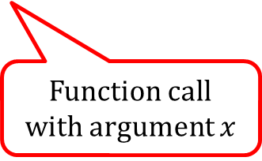
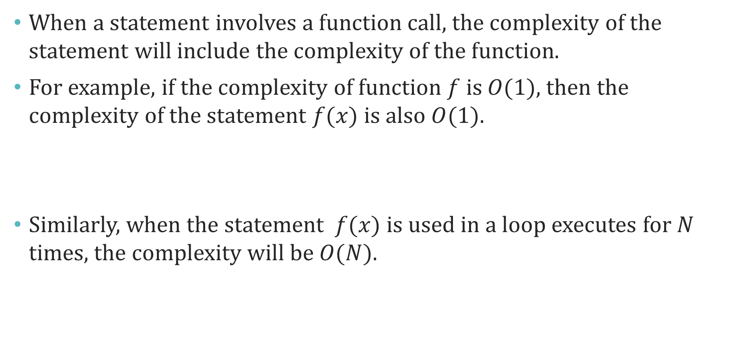
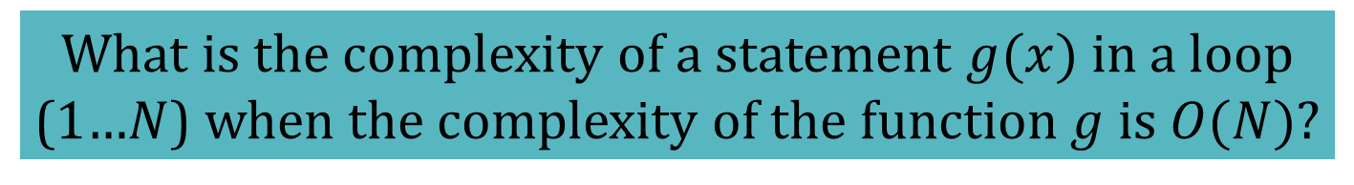
Statements with function calls
When a statement involves a function call, the complexity of the statement will include the complexity of the function.
For example, if the complexity of function $f$ is $O(1)$, then the complexity of the statement $f(x)$ is also $O(1)$.
Similarly, when the statement $f(x)$ is used in a loop executes for $N$ times, the complexity will be $O(N)$.
Function call with argument $x$
What is the complexity of a statement $g(x)$ in a loop (1…$N$) when the complexity of the function $g$ is $O(N)$?

Slide 20
Linear search

Slide 21
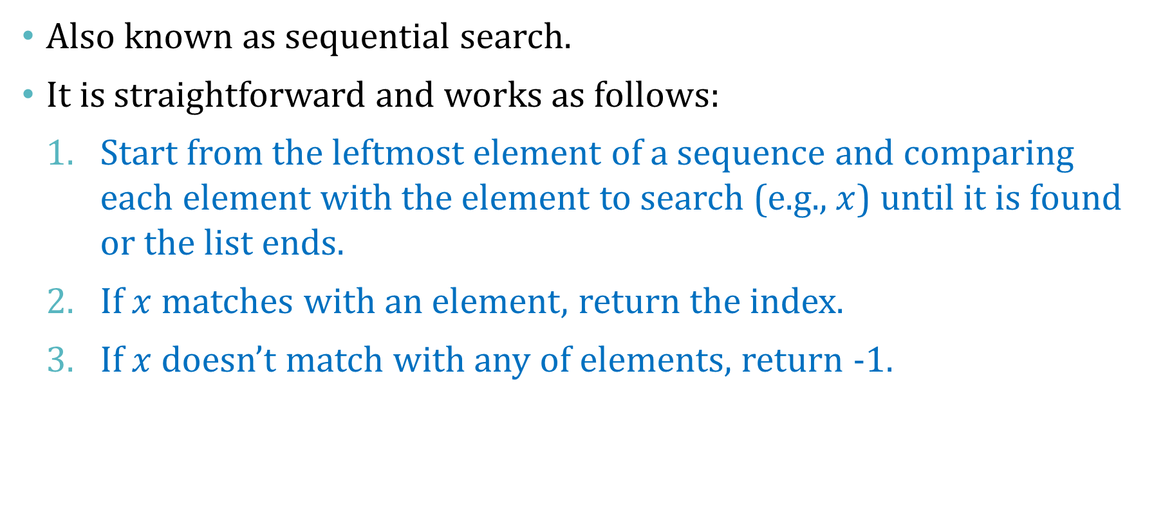
Linear search
Also known as sequential search.
It is straightforward and works as follows:
Start from the leftmost element of a sequence and comparing each element with the element to search (e.g., $x$) until it is found or the list ends.
If $x$ matches with an element, return the index.
If $x$ doesn’t match with any of elements, return -1.

Slide 22
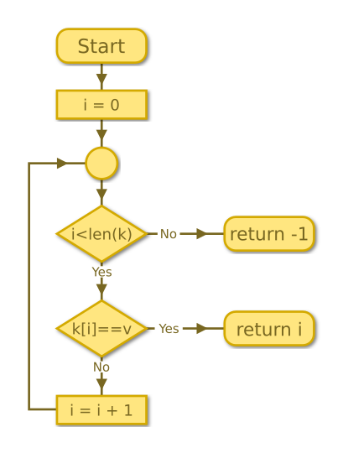
Linear search flowchart
[source]

Slide 23

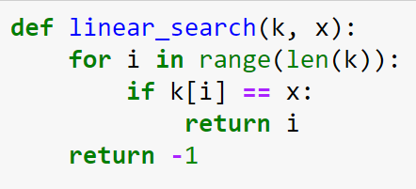

Linear search example 1
A finite sequence
Element to search

Slide 24
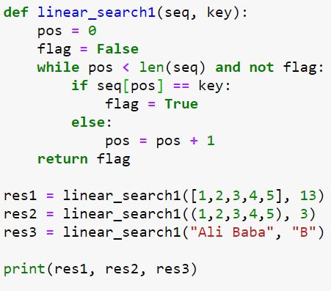
Linear search example 2
Position/index

Slide 25
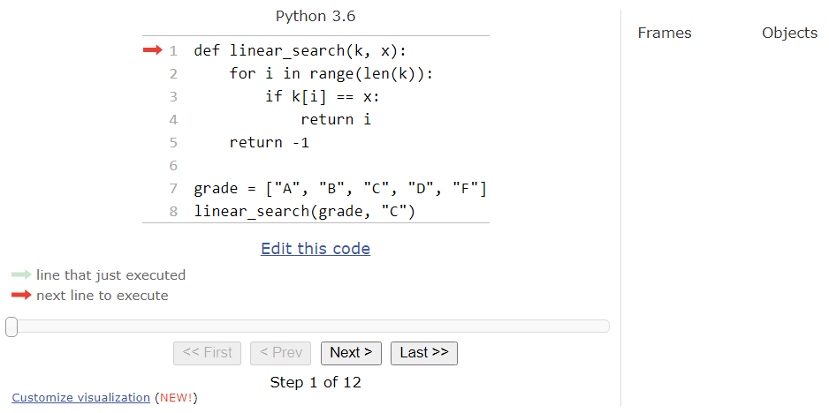
Linear search - Python tutor
[Demo]

Slide 26
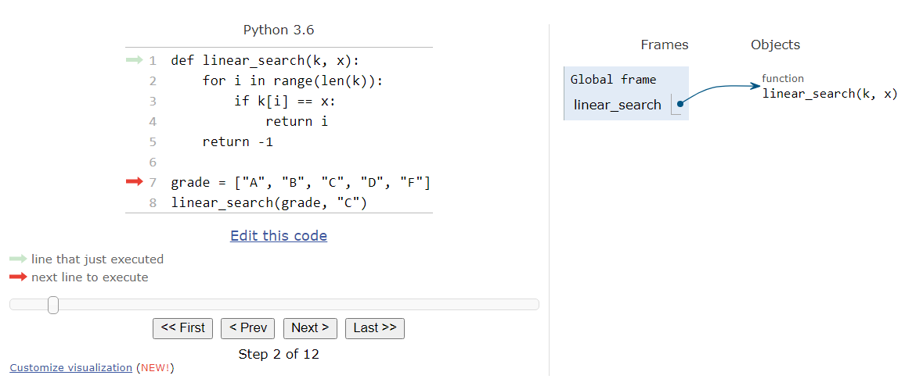
Linear search - Python tutor

Slide 27
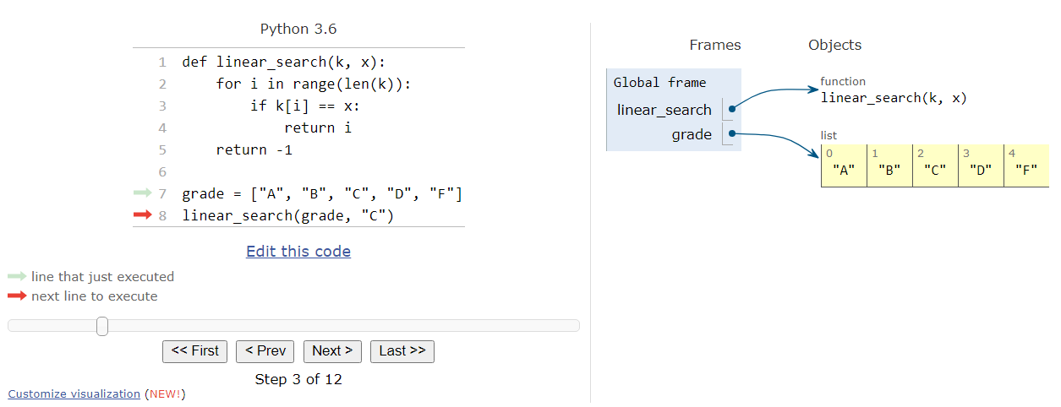
Linear search - Python tutor

Slide 28
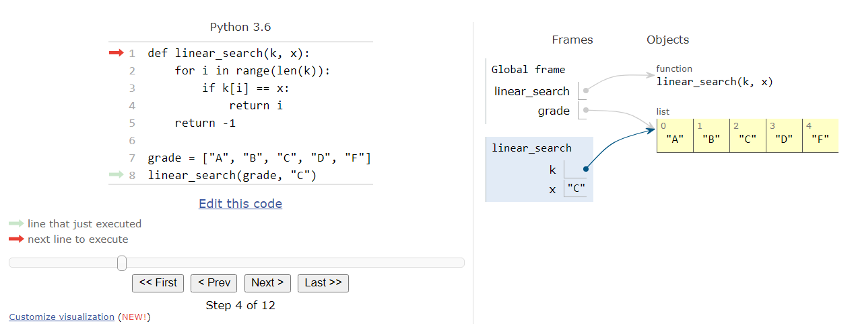
Linear search - Python tutor

Slide 29
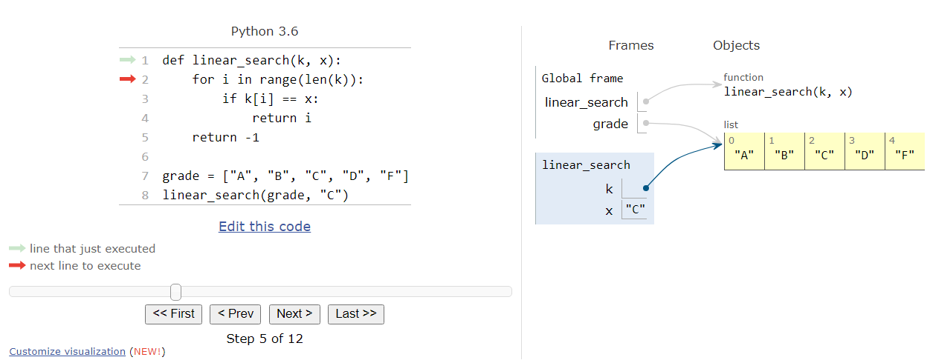
Linear search - Python tutor

Slide 30
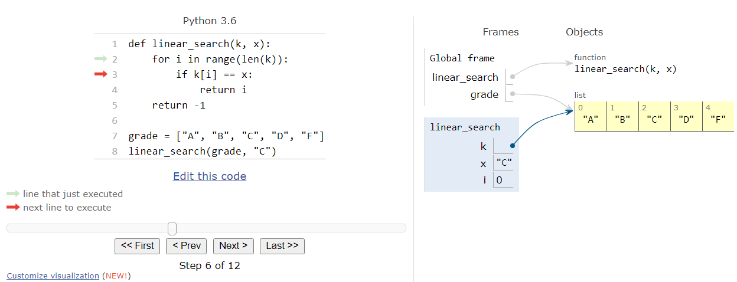
Linear search - Python tutor

Slide 31
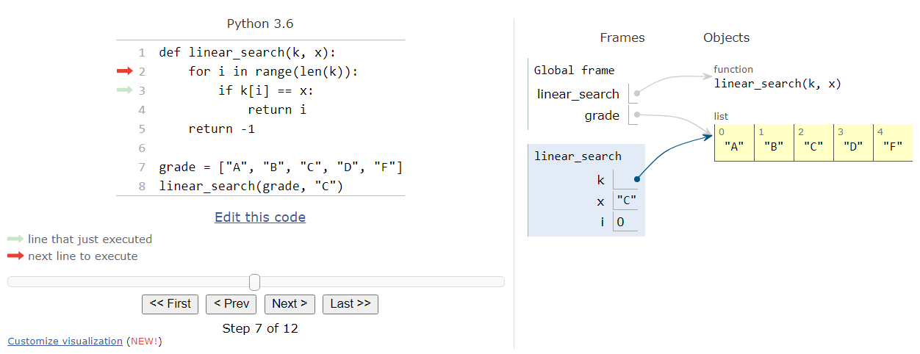
Linear search - Python tutor

Slide 32
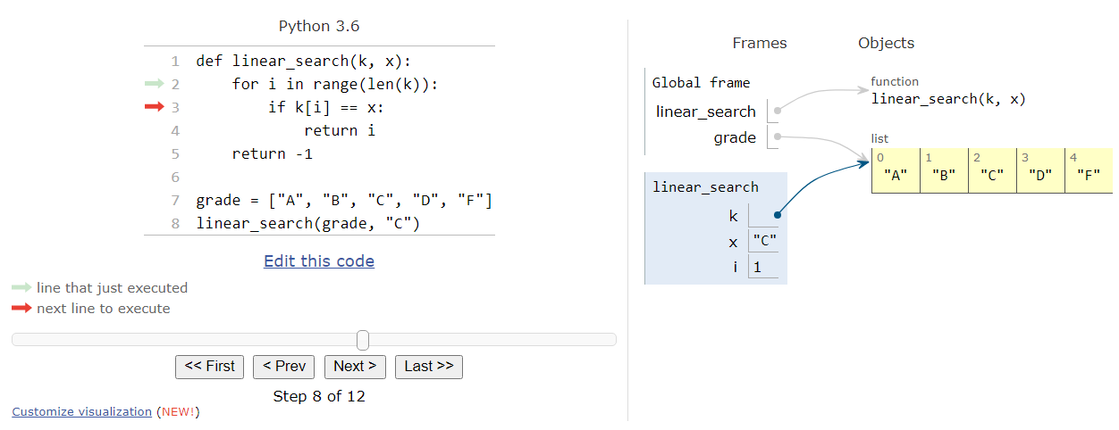
Linear search - Python tutor

Slide 33
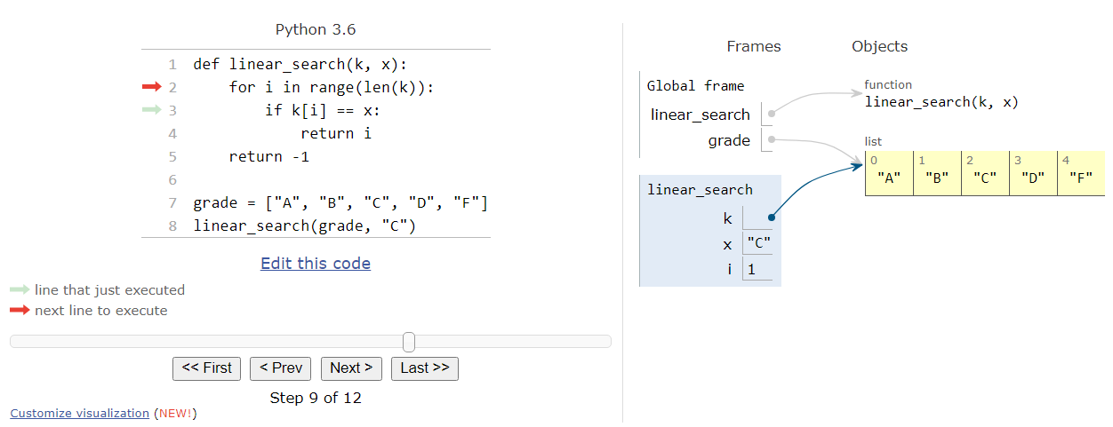
Linear search - Python tutor

Slide 34
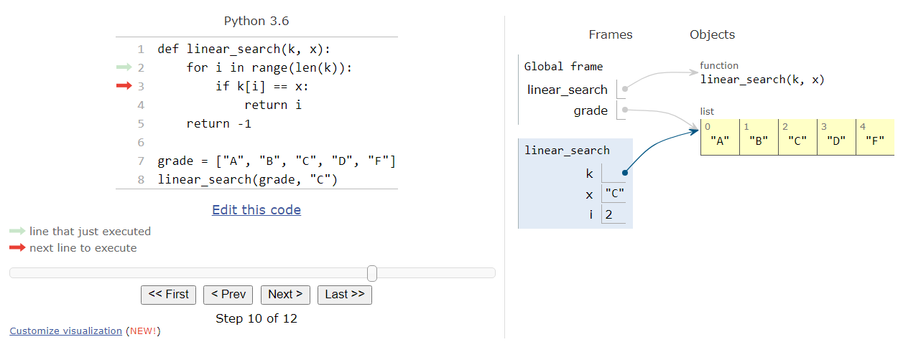
Linear search - Python tutor

Slide 35
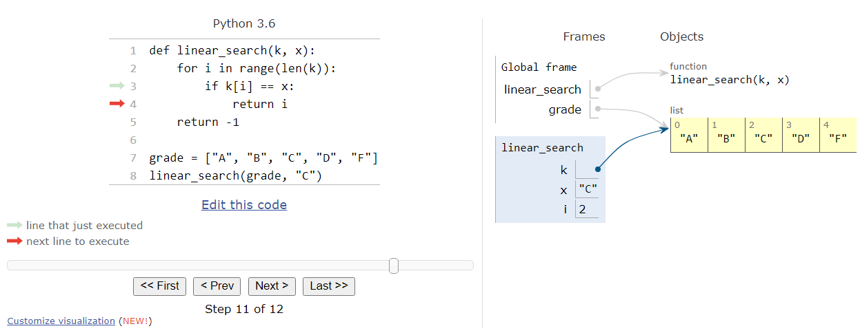
Linear search - Python tutor

Slide 36
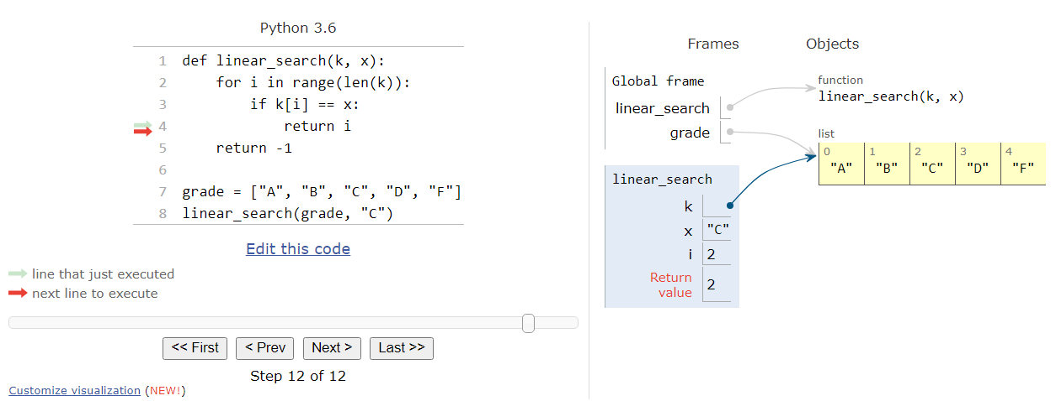
Linear search - Python tutor

Slide 37
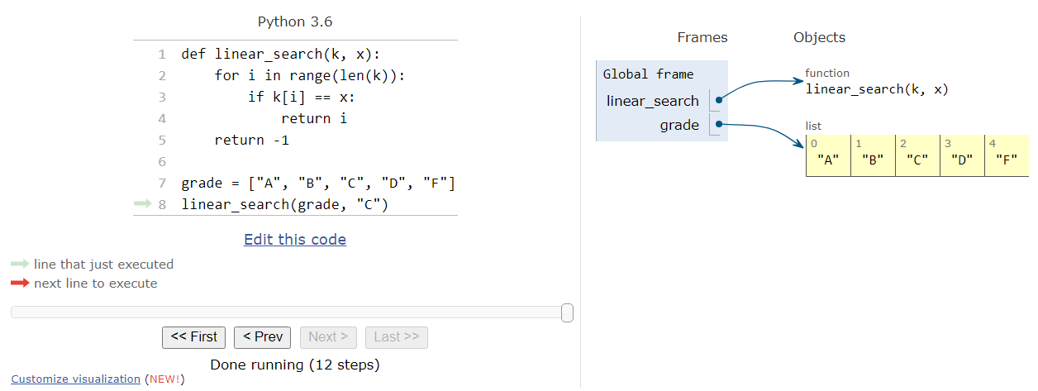
Linear search - Python tutor

Slide 38
Extra practice
Problem 1: Request the user to enter an item to search from a pre-defined sequence (string, tuple, or list).
Problem 2: Request the user to enter an item to search from two pre-defined sequences (string, tuple, or list). If the item is found in both sequences, return TRUE.
Problem 3: Request the user to enter a sequence (string, tuple, or list) and then an item to search. Show a menu to let the user choose which type of sequence to be used.
Think about the outputs that we should print on screen. Also, do we need to validate the user’s input?

